Slide 1
Chapter 5:
Project Time Management

Slide 2
Importance of Project Schedules
Managers often cite delivering projects on time as one of their biggest challenges
Average time overrun from 1995 CHAOS report was 222%; improved to 63% in 2001 study
Time has the least amount of flexibility; it passes no matter what
Schedule issues are the main reason for conflicts on projects, especially during the second half of projects

Slide 3
Project Time Management Processes
Project time management involves the processes required to ensure timely completion of a project. Processes include:
  Activity definition
  Activity sequencing
  Activity duration estimating
  Schedule development
  Schedule control

Slide 4
Where Do Schedules Come From? Defining Activities
Project schedules grow out of the basic document that initiate a project
  Project charter includes start and end dates and budget information
  Scope statement and WBS help define what will be done
Activity definition involves developing a more detailed WBS and supporting explanations to understand all the work to be done

Slide 5
Activity Sequencing
Involves reviewing activities and determining dependencies
  Mandatory dependencies: inherent in the nature of the work
    Ex: Accepting a marriage proposal before planning a wedding
  Discretionary dependencies: defined by the project team
    Ex: Choosing a band for the reception before the location
  External dependencies: involve relationships between project and non-project activities
    Ex: Making sure there is a vegetarian meal option for guests at the reception
You must determine dependencies in order to use critical path analysis

Slide 6
Project Network Diagrams
Project network diagrams are the preferred technique for showing activity sequencing
A project network diagram is a schematic display of the logical relationships among, or sequencing of, project activities

Slide 7
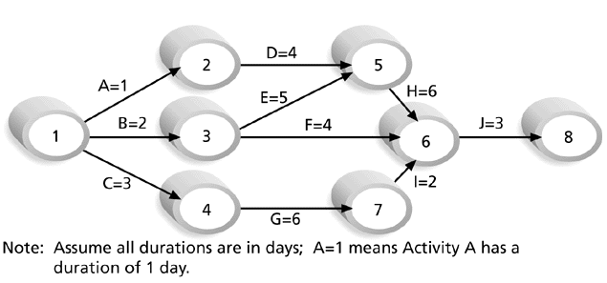
Figure 5-2. Sample Activity-on-Arrow (AOA) Network Diagram for Project X

Slide 8
Arrow Diagramming Method (ADM)
Also called activity-on-arrow (AOA) project network diagrams
Activities are represented by arrows
Nodes or circles are the starting and ending points of activities
Can only show finish-to-start dependencies

Slide 9
Process for Creating AOA Diagrams
1. Find all of the activities that start at node 1. Draw their finish nodes and draw arrows between node 1 and those finish nodes. Put the activity letter or name and duration estimate on the associated arrow
2. Continuing drawing the network diagram, working from left to right. Look for bursts and merges. Bursts occur when a single node is followed by two or more activities. A merge occurs when two or more nodes precede a single node
3. Continue drawing the project network diagram until all activities are included on the diagram that have dependencies
4. As a rule of thumb, all arrowheads should face toward the right, and no arrows should cross on an AOA network diagram

Slide 10
Wedding Plan Activity-on-Arrow
Choose menu plans
Buy Wedding Dress
Pick Location
5
15
25
5
Set wedding date
Have Bridal Shower
3
Get Married
Bride Only

Slide 11
Wedding Plan Activity-on-Arrow
Choose menu plans
Buy Wedding Dress
Pick Location
5
15
25
5
Invite guests
Buy dress for wedding
Set wedding date
Have Bridal Shower
15
5
5
3
Get Married
Mother of Bride

Slide 12
Wedding Plan Activity-on-Arrow
Choose menu plans
Buy Wedding Dress
Pick Location
5
15
25
5
Invite guests
Buy dress for wedding
Set wedding date
Have Bridal Shower
15
5
5
35
3
Have Bachelor Party
3
Get Married
Groom

Slide 13
Precedence Diagramming Method (PDM)
Activities are represented by boxes
Arrows show relationships between activities
More popular than ADM method and used by project management software
Better at showing different types of dependencies

Slide 14
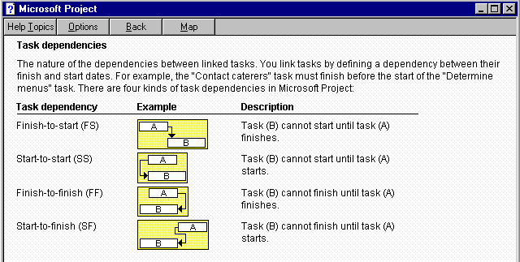
Figure 5-3. Task Dependency Types

Slide 15
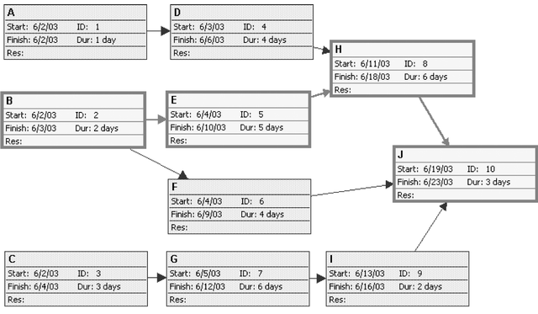
Figure 5-4. Sample Precedence Diagramming Method (PDM) Network Diagram for Project X

Slide 16
Activity Duration Estimating
After defining activities and determining their sequence, the next step in time management is duration estimating
Duration includes the actual amount of time worked on an activity plus elapsed time
People doing the work should help create estimates, and an expert should review them

Slide 17
Schedule Development
Schedule development uses results of the other time management processes to determine the start and end date of the project and its activities
Ultimate goal is to create a realistic project schedule that provides a basis for monitoring project progress for the time dimension of the project
Important tools and techniques include Gantt charts, PERT analysis, critical path analysis, and critical chain scheduling

Slide 18
Gantt Charts
Gantt charts provide a standard format for displaying project schedule information by listing project activities and their corresponding start and finish dates in a calendar format
Symbols include:
  A black diamond: milestones or significant events on a project with zero duration
  Thick black bars: summary tasks
  Lighter horizontal bars: tasks
  Arrows: dependencies between tasks

Slide 19
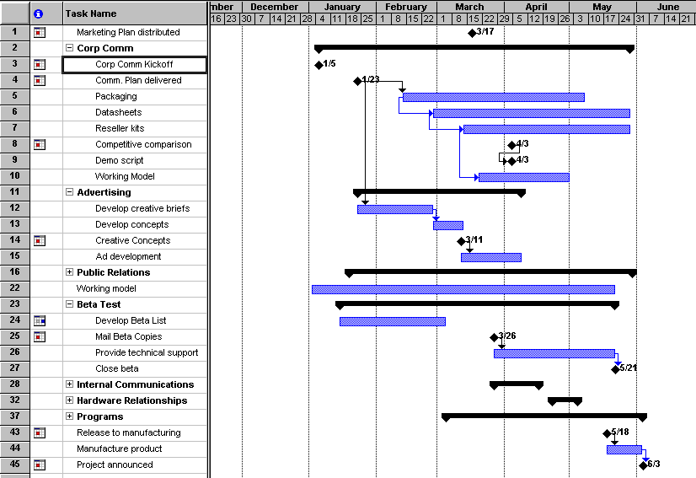
Figure 5-6. Gantt Chart for Software Launch Project

Slide 20
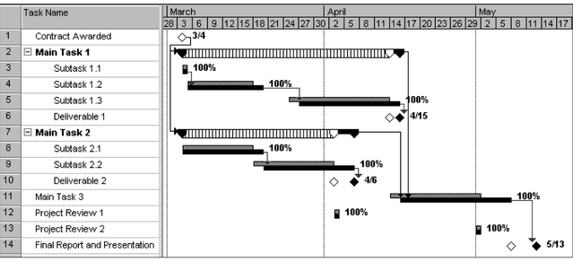
Figure 5-7. Sample Tracking Gantt Chart
white diamond: slipped milestone
two bars: planned and actual times

Slide 21
Critical Path Method (CPM)
CPM is a project network analysis technique used to predict total project duration
A critical path for a project is the series of activities that determines the earliest time by which the project can be completed
The critical path is the longest path through the network diagram and has the least amount of slack or float

Slide 22
Finding the Critical Path
First develop a good project network diagram
Add the durations for all activities on each path through the project network diagram
The longest path is the critical path

Slide 23
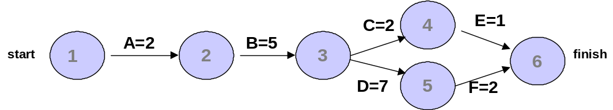
Simple Example of Determining the Critical Path
Consider the following project network diagram. Assume all times are in days.
a. How many paths are on this network diagram?
b. How long is each path?
c. Which is the critical path?
d. What is the shortest amount of time needed to complete this project?

Slide 24
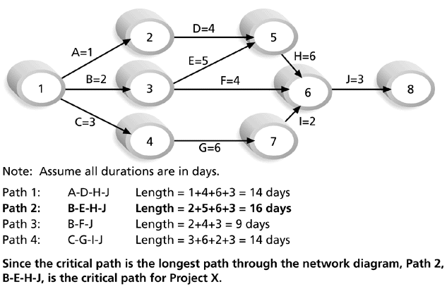
Figure 5-8. Determining the Critical Path for Project X

Slide 25
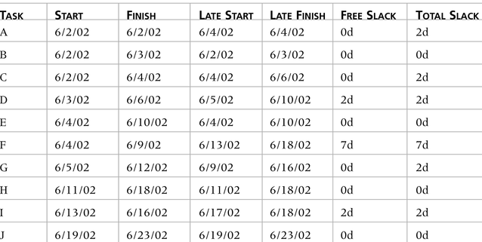
Table 5-1. Free and Total Float or Slack for Project X

Slide 26
Wedding Plan Activity-on-Arrow
Choose menu plans
Buy Wedding Dress
Pick Location
5
15
25
5
Invite guests
Buy dress for wedding
Set wedding date
Have Bridal Shower
15
5
5
35
3
Have Bachelor Party
3
Get Married

Slide 27
More on the Critical Path
If one of more activities on the critical path takes longer than planned, the whole project schedule will slip unless corrective action is taken
Misconceptions:
  The critical path is not the one with all the critical activities; it only accounts for time
  There can be more than one critical path if the lengths of two or more paths are the same
  The critical path can change as the project progresses

Slide 28
Using Critical Path Analysis to Make Schedule Trade-offs
Knowing the critical path helps you make schedule trade-offs
Free slack or free float is the amount of time an activity can be delayed without delaying the early start of any immediately following activities

Slide 29
Techniques for Shortening a Project Schedule
Shortening durations of critical tasks by adding more resources or changing their scope
Crashing tasks by obtaining the greatest amount of schedule compression for the least incremental cost
Fast tracking tasks by doing them in parallel or overlapping them

Slide 30
Importance of Updating Critical Path Data
It is important to update project schedule information
The critical path may change as you enter actual start and finish dates
If you know the project completion date will slip, negotiate with the project sponsor

Slide 31
Program Evaluation and Review Technique (PERT)
PERT is a network analysis technique used to estimate project duration when there is a high degree of uncertainty about the individual activity duration estimates
PERT uses probabilistic time estimates based on using optimistic, most likely, and pessimistic estimates of activity durations

Slide 32
PERT Formula and Example
PERT weighted average formula:
optimistic time + 4X most likely time + pessimistic time
6
Example:
PERT weighted average =
8 workdays + 4 X 10 workdays + 24 workdays = 12 days 6
where 8 = optimistic time, 10 = most likely time, and 24 = pessimistic time

Slide 33
Controlling Changes to the Project Schedule
Perform reality checks on schedules
Allow for contingencies
Don’t plan for everyone to work at 100% capacity all the time
Hold progress meetings with stakeholders and be clear and honest in communicating schedule issues

Slide 34
Working with People Issues
Strong leadership helps projects succeed more than good PERT charts
Project managers should use
  empowerment
  incentives
  discipline
  negotiation

Slide 35
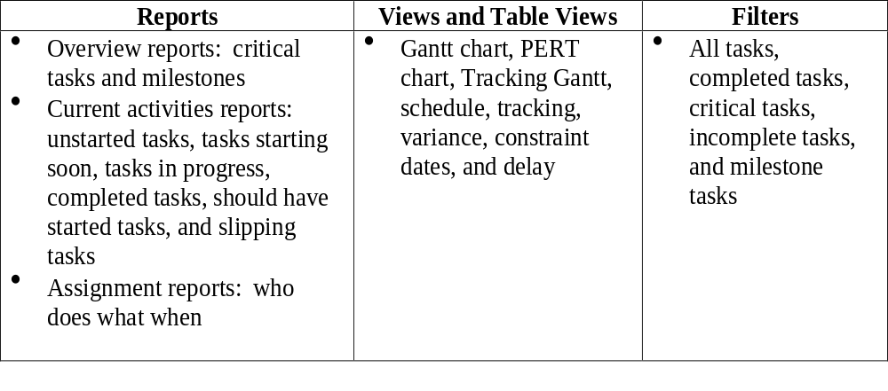
Table 5-2. Project 98 Features Related to Project Time Management

Slide 36
Words of Caution on Using Project Management Software
Many people misuse project management software because they don’t understand important concepts and have not had good training
You must enter dependencies to have dates adjust automatically and to determine the critical path
You must enter actual schedule information to compare planned and actual progress

Slide 37
Chapter 6:
Project Cost Management

Slide 38
The Importance of Project Cost Management
IT projects have a poor track record for meeting cost goals
Average cost overrun from 1995 CHAOS study was 189% of the original estimates; improved to 45% in the 2001 study
In 1995, cancelled IT projects cost the U.S. over $81 billion

Slide 39
What is Cost and Project Cost Management?
Cost is a resource sacrificed or fore-gone to achieve a specific objective or something given up in exchange
Costs are usually measured in monetary units like dollars
Project cost management includes the processes required to ensure that the project is completed within an approved budget

Slide 40
Project Cost Management Processes
Resource planning: determining what resources and quantities of them should be used
Cost estimating: developing an estimate of the costs and resources needed to complete a project
Cost budgeting: allocating the overall cost estimate to individual work items to establish a baseline for measuring performance
Cost control: controlling changes to the project budget

Slide 41
Quick Quiz on Cost Concepts
Suppose you sell 10 widgets per day on average, and the average cost per widget is $10. If you sold 11 widgets one day, what would the affect on profits be?
Suppose you were buying 10 PCs for your new business. What would some of the life cycle costs be?
Give examples of “tangible” vs. “intangible” benefits of a new project

Slide 42
Basic Principles of Cost Management
Most CEOs and boards know a lot more about finance than IT, IT project managers must speak their language
  Profits are revenues minus expenses
  Life cycle costing is estimating the cost of a project over its entire life
  Cash flow analysis is determining the estimated annual costs and benefits for a project
  Benefits and costs can be tangible or intangible, direct or indirect
  Sunk cost should not be a criteria in project selection

Slide 43
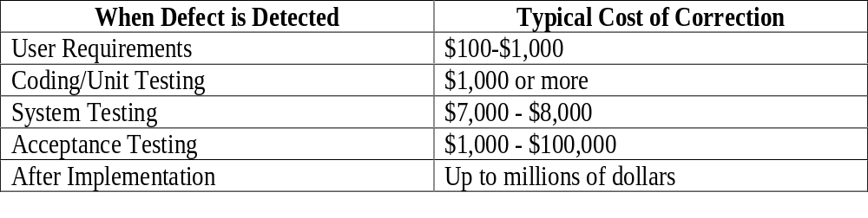
Table 6-1. Cost of Software Defects
It is important to spend money up-front on IT projects to avoid spending a lot more later.

Slide 44
Resource Planning
The nature of the project and the organization will affect resource planning
Some questions to consider:
  How difficult will it be to do specific tasks on the project?
  Is there anything unique in this project’s scope statement that will affect resources?
  What is the organization’s history in doing similar tasks?
  Does the organization have or can they acquire the people, equipment, and materials that are capable and available for performing the work?

Slide 45
Cost Estimating
An important output of project cost management is a cost estimate
There are several types of cost estimates and tools and techniques to help create them
It is also important to develop a cost management plan that describes how cost variances will be managed on the project

Slide 46
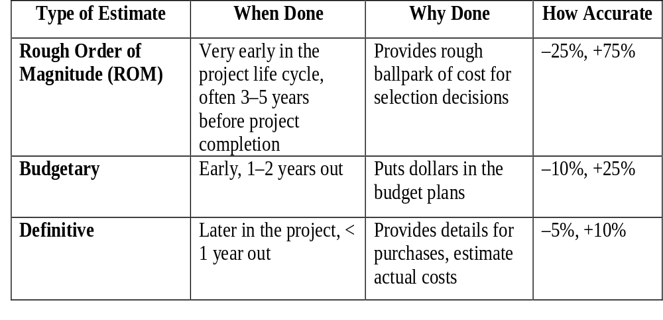
Table 6-2. Types of Cost Estimates

Slide 47
Cost Estimation Tools and Techniques
3 basic tools and techniques for cost estimates:
  analogous or top-down: use the actual cost of a previous, similar project as the basis for the new estimate
  bottom-up: estimate individual work items and sum them to get a total estimate
  parametric: use project characteristics in a mathematical model to estimate costs

Slide 48
Constructive Cost Model (COCOMO)
Barry Boehm helped develop the COCOMO models for estimating software development costs
Parameters include source lines of code or function points
COCOMO II is a computerized model available on the web
Boehm suggest that only parametric models do not suffer from the limits of human decision-making

Slide 49
Typical Problems with IT Cost Estimates
Developing an estimate for a large software project is a complex task requiring a significant amount of effort. Remember that estimates are done at various stages of the project
Many people doing estimates have little experience doing them. Try to provide training and mentoring
People have a bias toward underestimation. Review estimates and ask important questions to make sure estimates are not biased
Management wants a number for a bid, not a real estimate. Project managers must negotiate with project sponsors to create realistic cost estimates

Slide 50
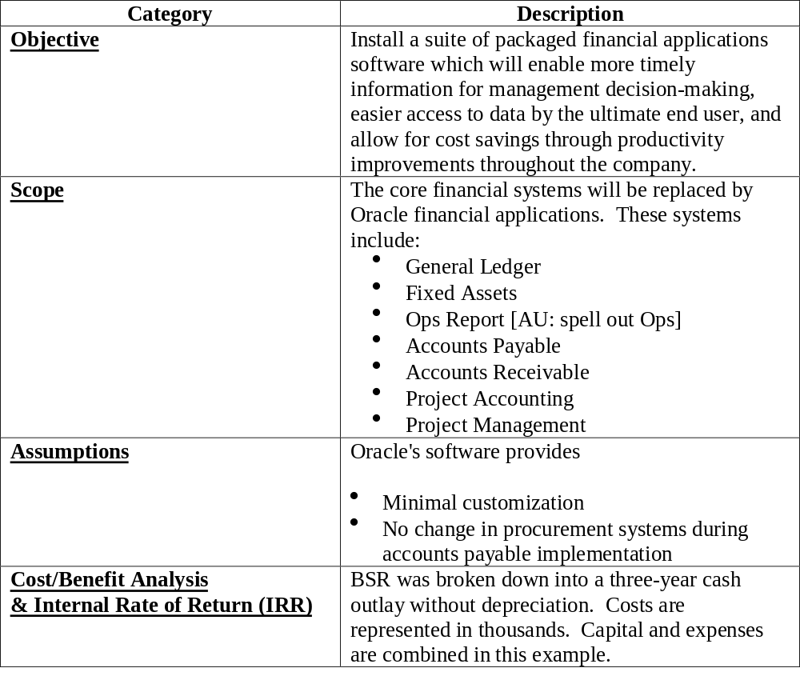
Table 6-3. Business Systems Replacement Project Cost Estimate Overview

Slide 51
Cost Budgeting
Cost budget involves allocating the project cost estimate to individual work items and providing a cost baseline
For example, in the Business Systems Replacement project, there was a total purchased costs estimate for FY97 of $600,000 and another $1.2 million for Information Services and Technology
These amounts were allocated to appropriate budgets as shown in Table 6-5

Slide 52
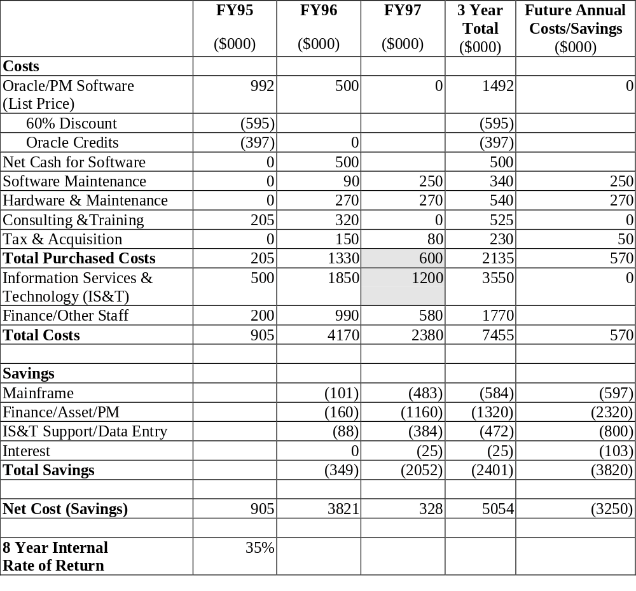
Table 6-4. Business Systems Replacement Project Cash Flow Analysis

Slide 53
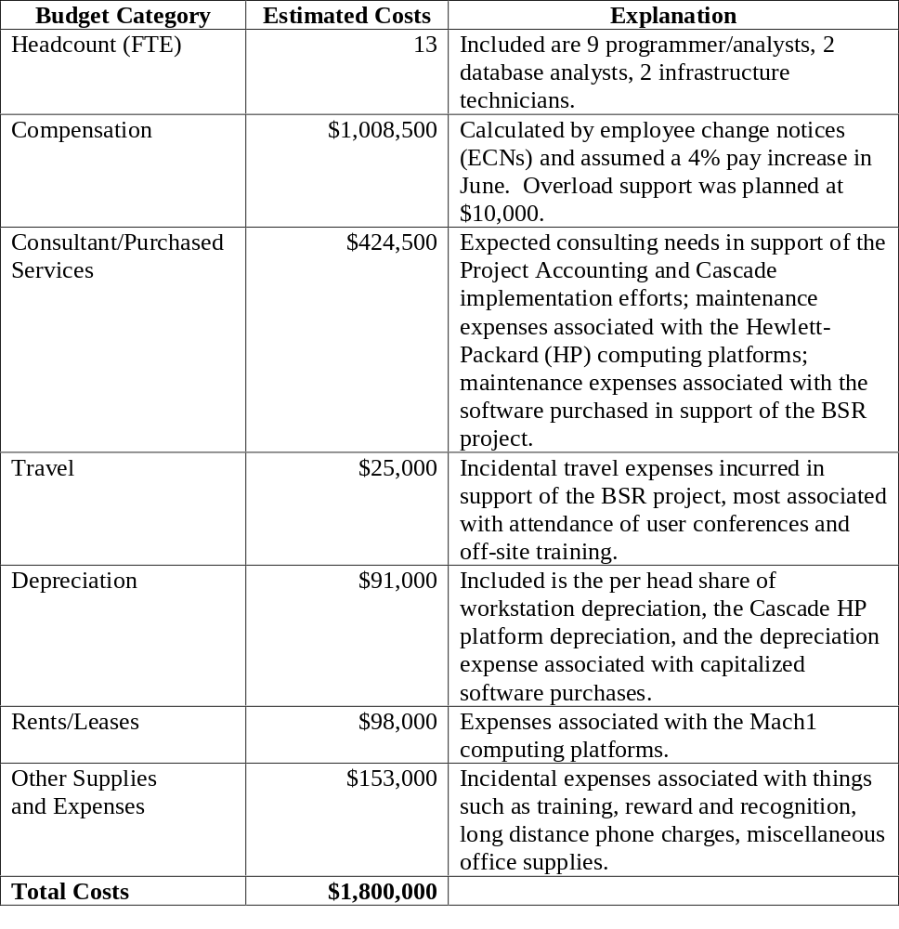
Table 6-5. Business Systems Replacement Project Budget Estimates for FY97 and Explanations

Slide 54
Cost Control
Project cost control includes
  monitoring cost performance
  ensuring that only appropriate project changes are included in a revised cost baseline
  informing project stakeholders of authorized changes to the project that will affect costs
Earned value management is an important tool for cost control

Slide 55
Earned Value Management (EVM)
EVM is a project performance measurement technique that integrates scope, time, and cost data
Given a baseline (original plan plus approved changes), you can determine how well the project is meeting its goals
You must enter actual information periodically to use EVM. Figure 6-1 shows a sample form for collecting information

Slide 56
Earned Value Management Terms
The planned value (PV), formerly called the budgeted cost of work scheduled (BCWS), also called the budget, is that portion of the approved total cost estimate planned to be spent on an activity during a given period
Actual cost (AC), formerly called actual cost of work performed (ACWP), is the total of direct and indirect costs incurred in accomplishing work on an activity during a given period
The earned value (EV), formerly called the budgeted cost of work performed (BCWP), is the percentage of work actually completed multiplied by the planned value

Slide 57
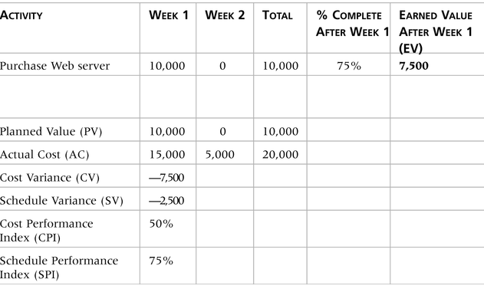
Table 6-6. Earned Value Calculations for One Activity After Week One

Slide 58
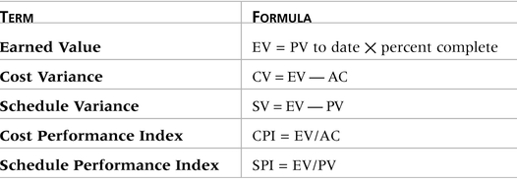
Table 6-7. Earned Value Formulas
To estimate what it will cost to complete a project or how long it will take based on performance to date, divide the budgeted cost or time by the appropriate index.

Slide 59
Rules of Thumb for EVA Numbers
Negative numbers for cost and schedule variance indicate problems in those areas. The project is costing more than planned or taking longer than planned
CPI and SPI less than 100% indicate problems

Slide 60
Using Software to Assist in Cost Management
Spreadsheets are a common tool for resource planning, cost estimating, cost budgeting, and cost control
Many companies use more sophisticated and centralized financial applications software for cost information
Project management software has many cost-related features

